Slide 1

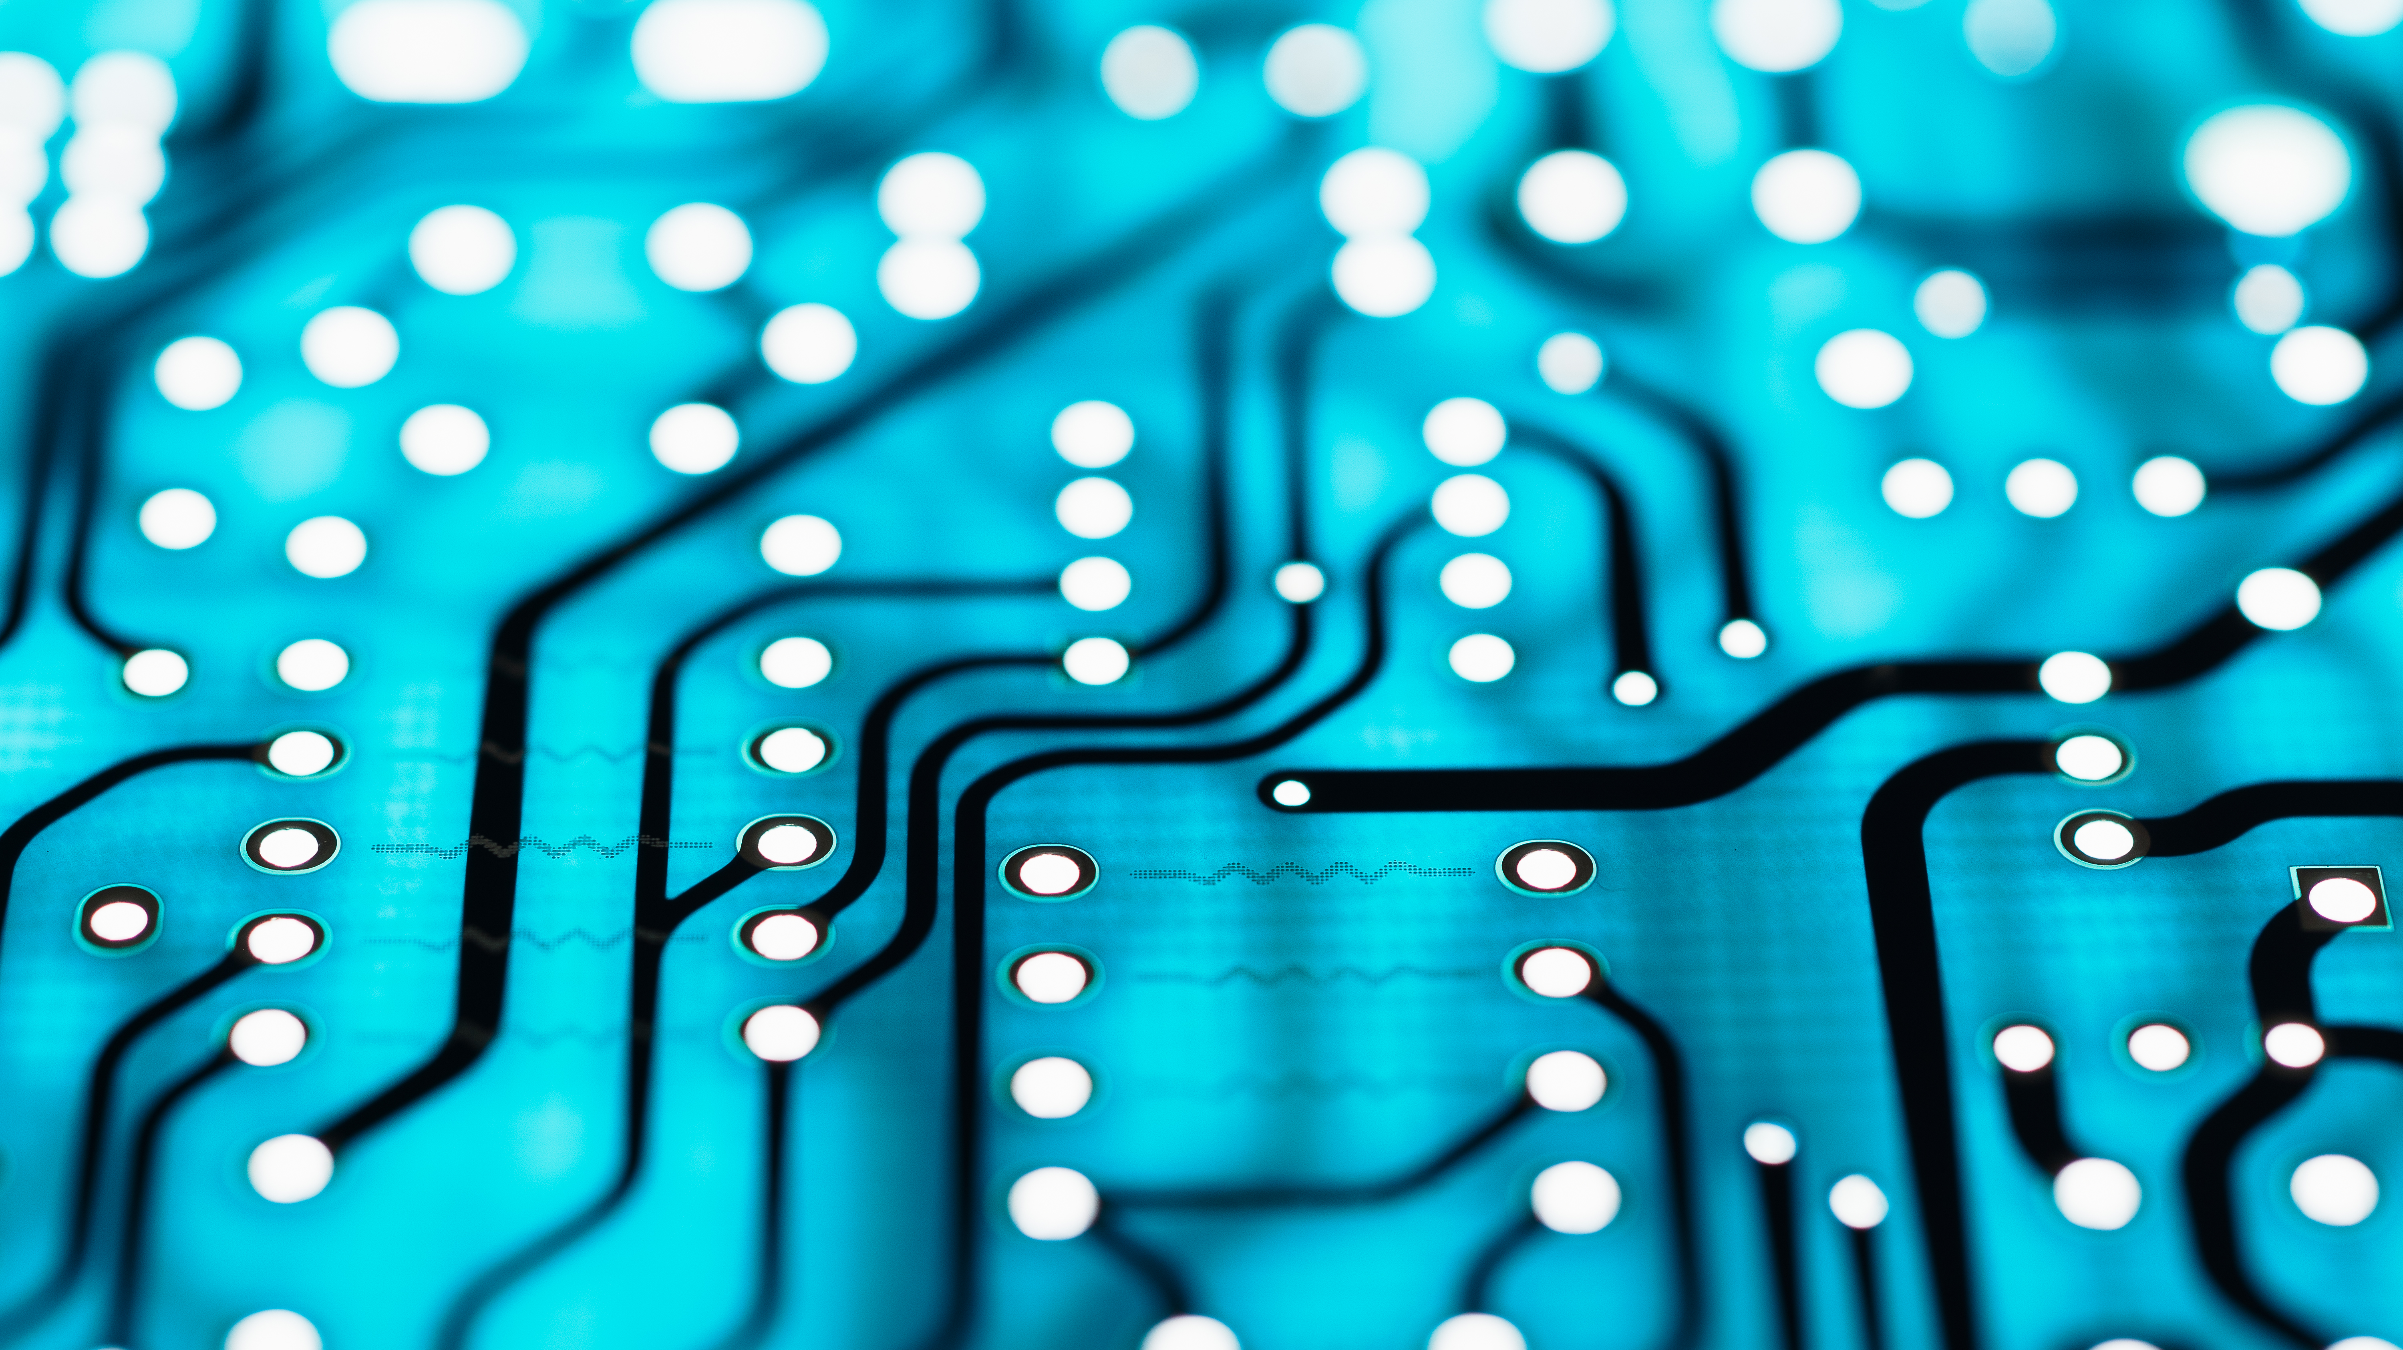
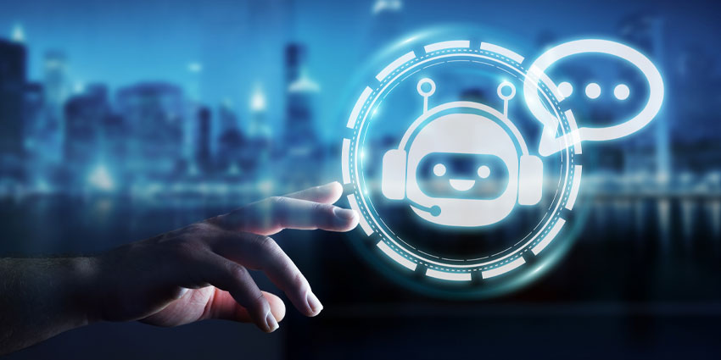
chatbots
GROUP NUMBER : 8
Alekhya Bulusu
Lalitha Nityasree
Kolimi Kavitha
Md. Mohtashim Maqsood

Slide 2
OBJECTIVE:
The objective of this project is to create a chatbot from scratch.
After execution of the code, the resultant chatbot will tend to the needs of the customer if available.
The said chatbot, when asked for will bring forth information regarding the temperature/weather, time, open apps etc.

Slide 3
WHAT IS A CHATBOT?
A chatbot is a computer program designed to simulate conversation with human users, either through text-based messaging or voice-based interactions.
Chatbots are typically powered by Machine Learning (ML) algorithms that enable them to understand natural language, analyze input, and generate appropriate responses.
They are commonly used in a wide range of applications, such as customer service, marketing, and personal assistance.

Slide 4
Chatbots can be integrated into messaging platforms, websites, mobile apps, and other digital interfaces to provide instant support and engagement to users.
They can be programmed to perform a wide range of tasks, such as answering customer support inquiries, scheduling appointments, making reservations, providing information, and even playing games.

Slide 5
TYPES OF CHATBOTS:
As Chatbots are still a relatively new business technology, debate surrounds how many different types of chatbots exist and what the industry should call them.
Some common types of chatbots include the following:
Rule-based chatbots: These chatbots are programmed with a predefined set of rules and decision trees to respond to specific user inputs. They are relatively simple and can only provide predetermined responses to limited types of questions.
AI-based chatbots: These chatbots use artificial intelligence (AI) and natural language processing (NLP) algorithms to understand user inputs and generate relevant responses. They can learn and improve their responses over time based on user interactions.

Slide 6
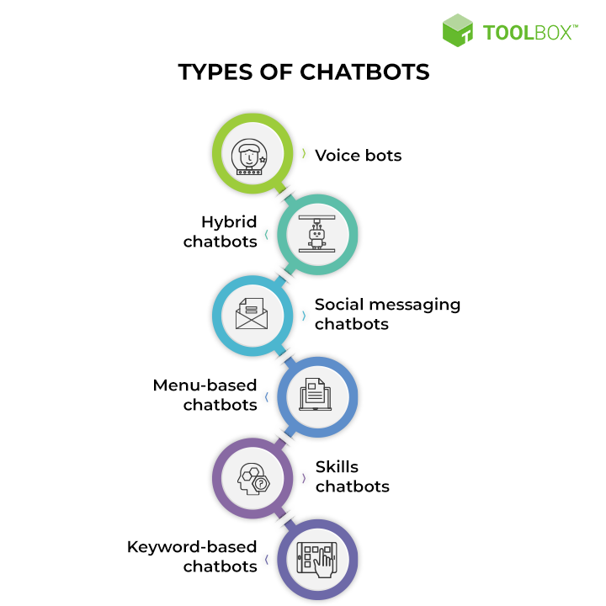
Hybrid chatbots: These chatbots combine both rule-based and AI-based approaches to provide a more robust and versatile user experience. They can handle simple queries using rules and more complex queries using AI algorithms.
Voice assistants: These chatbots are designed to interact with users via voice commands instead of text. They can perform various tasks, such as playing music, setting reminders, and providing information.
Social media chatbots: These chatbots are integrated into social media platforms, such as Facebook Messenger and Twitter, to interact with users and provide support or information.

Slide 7
REVIEW OF LITERATURE:
https://chatbotsmagazine.com/design-framework-for-chatbots-aa27060c4ea3
https://chatbotsmagazine.com/contextual-chat-bots-with-tensorflow-4391749d0077
https://pub.towardsai.net/build-chatgpt-like-chatbots-with-customized-knowledge-for-your-websites-using-simple-programming-f393206c6626
https://www.researchgate.net/publication/360620158_ARTIFICIAL_INTELLIGENCE_CHATBOT_USING_PYTHON#:~:text=Abstract,blends%20the%20response%20with%20
The zip file containing the code and libraries necessary-

Slide 8
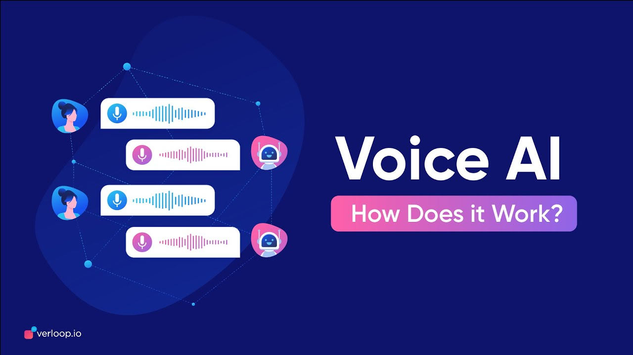
The above links contain information, basic terminology, steps to design data frames and algorithms to develop a contextual chatbot with TensorFlow.
The zip file consists of a simple code to create a chatbot to answer the queries of the users. It also contains the libraries that need to be imported for successful execution of the code.
In this project, a speech to speech chatbot has been created from scratch.

Slide 9
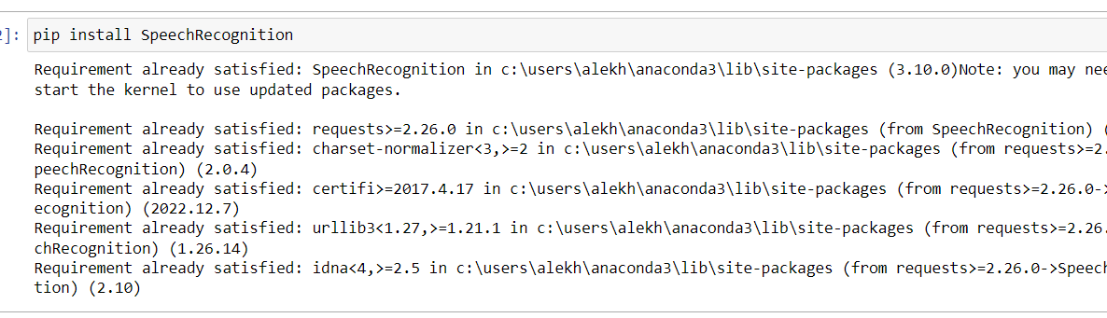
Libraries used:
Speech recognition is a technology that allows computers to understand and interpret human speech. It involves the use of algorithms and machine learning models to analyze audio signals and convert them into text or commands that can be processed by a computer.

Slide 10
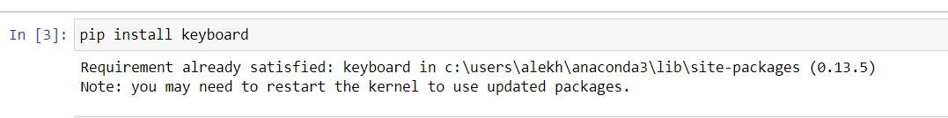
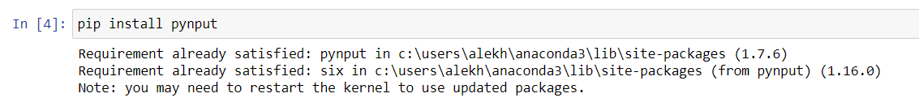
A keyboard library for chatbots is a software library that provides a graphical user interface (GUI) for users to interact with a chatbot using buttons and menus, instead of typing out their queries. The keyboard library can provide a number of benefits to chatbot users, such as faster interaction and improved usability.
Pyautogui is a Python library that allows developers to control the mouse and keyboard on a computer. It provides a set of functions to simulate mouse clicks, keyboard key presses and releases, and other mouse and keyboard actions. This library can be used in chatbot development to simulate user input and automate repetitive tasks.

Slide 11
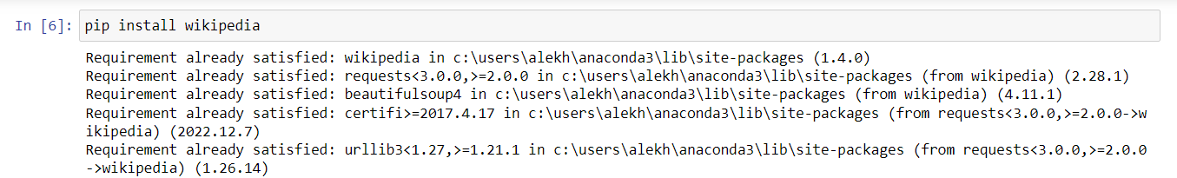
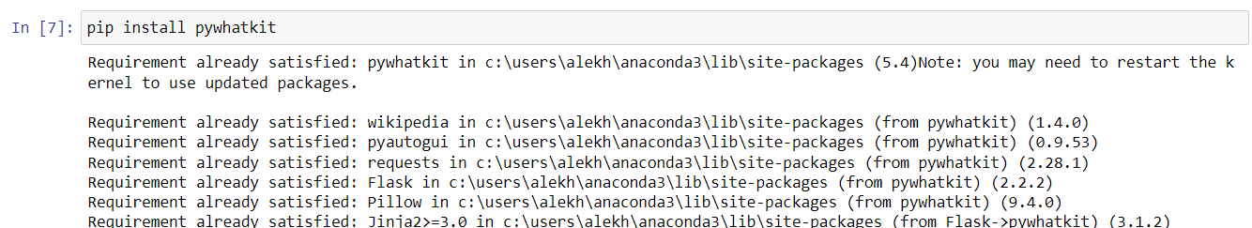
The Wikipedia library is a Python library that allows developers to access and interact with the Wikipedia API. The Wikipedia library is a useful tool for chatbot developers who want to create chatbots that can provide information and answer questions using Wikipedia as a source.
Pywhatkit is a valuable tool for chatbot developers who want to enhance the functionality and user experience of their chatbot applications. By using Pywhatkit, chatbots can perform a wide range of tasks, from simple information retrieval to more complex and interactive features such as sending emails, searching for information on Google, generating QR codes, and playing YouTube videos.

Slide 12
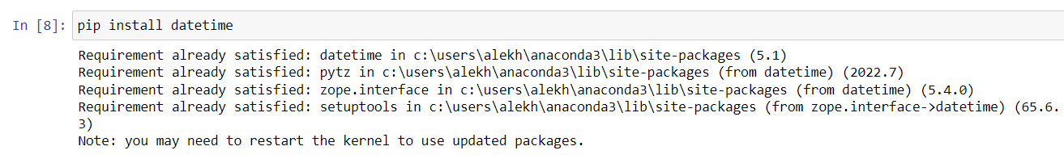
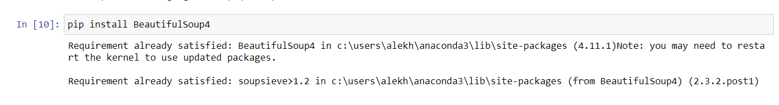
The datetime library is a built-in Python library that provides functionality for working with dates and times. The datetime library is a powerful and versatile tool for chatbot development, and it can be used to create chatbots that can interact with users based on a wide range of date and time information.
With BeautifulSoup4, chatbot developers can easily extract data from web pages and use it to create chatbot responses.

Slide 13
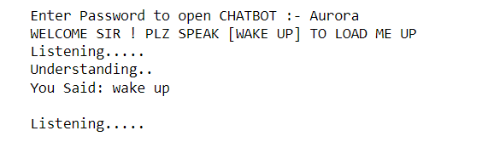
OUTPUT/Services provided by the built chatbot:
After importing all the required libraries mentioned above and executing a few more lines of code, the desired chatbot is built.
Once the last line of code is executed, the password is asked which is also provided in the zip file.
After entering the password the chatbot is activated by saying the phrase “wake up”.

Slide 14
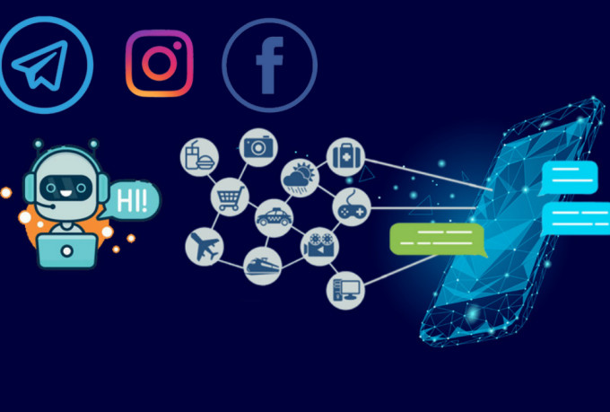
Once the chatbot is activated, it is capable of providing the following services if asked for:
Information about the temperature/weather.
Providing customer with the time.
Opening apps available on the PC.
Turning the system’s volume up/down.
Shutting the system down.
Clicking a screenshot/ your picture.
Searching for asked information on Google, YouTube or Wikipedia.

Slide 15
Benefits of chatbots:
Chatbots have become increasingly popular in recent years due to the numerous benefits they offer. Some of the benefits of chatbots include:
Improved customer service: Chatbots provide 24/7 customer support, helping customers get quick and accurate answers to their questions and concerns.
Increased efficiency: Chatbots can handle multiple conversations at once, making them more efficient than human customer service representatives.
Cost savings: Chatbots can significantly reduce costs for businesses by reducing the need for human customer service representatives.
Personalization: Chatbots can provide personalized interactions with customers by using information such as user history and preferences to provide relevant recommendations and solutions.
Increased engagement: Chatbots can increase customer engagement by providing interactive and conversational experiences.
Multilingual support: Chatbots can communicate with customers in multiple languages, making them accessible to a global audience.

Slide 16
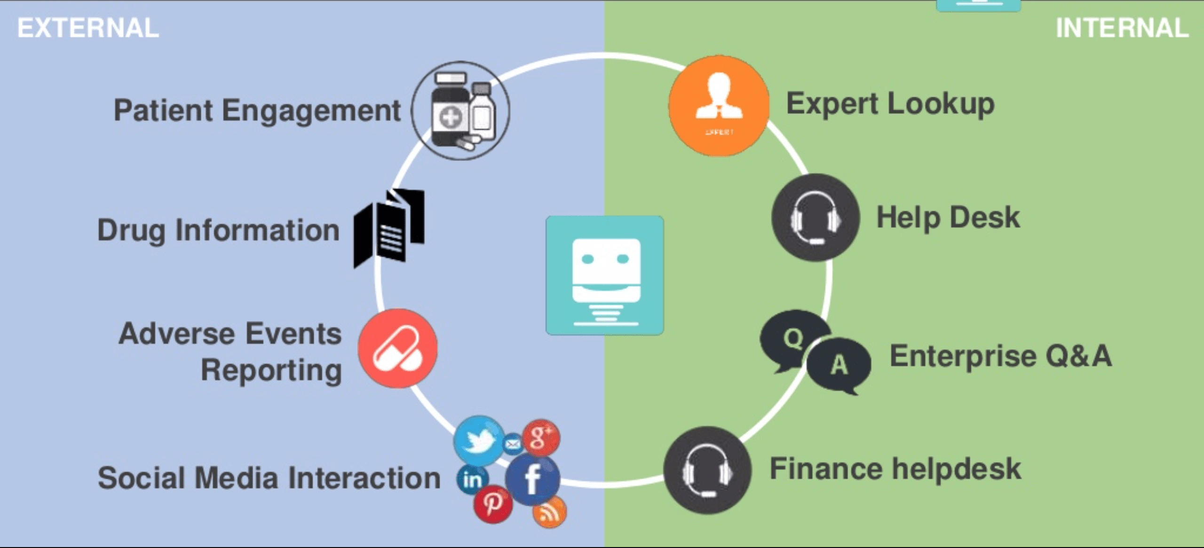
Use cases of chatbots:
Chatbots can be used in a variety of industries and for a range of purposes. Some common use cases of chatbots include:
Customer service: Chatbots can be used to provide 24/7 customer support, answering frequently asked questions, resolving issues, and directing customers to the appropriate resources.
Entertainment: Chatbots can be used to provide personalized recommendations for movies, TV shows, and music, and provide interactive experiences such as quizzes and games.

Slide 17
E-commerce: Chatbots can be used to help customers find products, make purchases, and track orders.
Healthcare: Chatbots can be used to provide medical advice, schedule appointments, and remind patients to take medication.
Banking: Chatbots can be used to help customers manage their accounts, make transactions, and resolve issues.
Travel: Chatbots can be used to provide travel information, book flights and hotels and provide recommendations for local activities and attractions.
Education: Chatbots can be used to provide online tutoring, answer student questions, and provide feedback on assignments.

Slide 18
Limitations of chatbots:
While chatbots offer many benefits, there are also some limitations to consider. Some of the key limitations of chatbots include:
Limited functionality: Chatbots are designed to perform specific tasks, which means they may not be able to handle more complex or nuanced interactions.
Lack of human touch: Chatbots lack the human touch and empathy that can be important in certain situations, such as when dealing with emotional or sensitive issues.
Need for ongoing maintenance: Chatbots require ongoing maintenance and updates to ensure they continue to function properly and deliver a positive user experience.
Accuracy issues: Chatbots may make errors in understanding and responding to user input, which can lead to frustration for users.

Slide 19
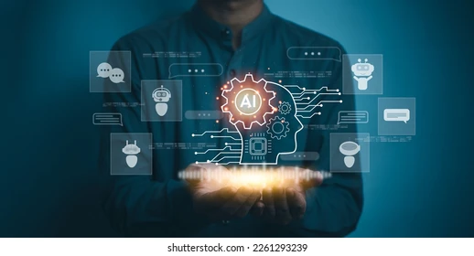
Role of data science in chatbots:
Data science plays a critical role in the development and optimization of chatbots. By leveraging data science techniques such as NLP, machine learning, and sentiment analysis, businesses can create chatbots that are more effective, personalized, and engaging for users.
Data science techniques can be used to analyze user data and preferences, allowing chatbots to provide more personalized recommendations and solutions.

Slide 20
Conclusion:
In conclusion, chatbots offer a wide range of benefits and use cases for businesses and organizations of all types by providing 24/7 customer support, streamlining operations, and providing personalized interactions.
While there are some limitations to consider, such as language limitations and accuracy issues, these can be mitigated through careful design and ongoing maintenance. Data science plays a crucial role in the development and optimization of chatbots.
Overall, chatbots represent an exciting and rapidly evolving technology that holds great promise for businesses looking to enhance customer experiences and drive growth

